Slide 1
Fresher Training Program
Date: 07th Oct 2024

Slide 2
Agenda
Overview of Programming
Computer science
System Architecture in seconds
System Architecture in Detail
FE - Frontend
React.js
Best practices
BE – Backend
Practical Project
Java core
Springboot, etc.
Agile scrum
Business Analyzing
Implementing features
Teamwork
Past
Now

Slide 3
Section 1: Programming Overview
Computer
Programming
System Architecture in seconds
Use cases

Slide 4

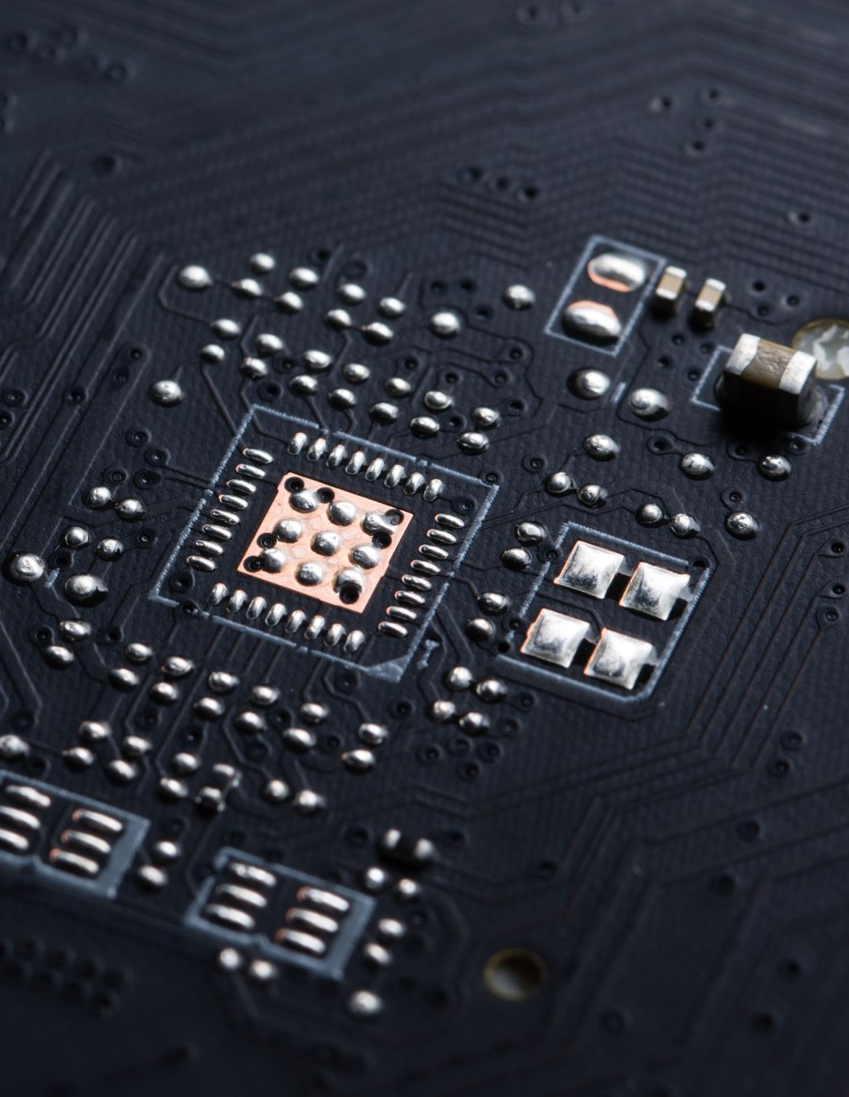
I. Computer
Hardware is the physical and electronic parts of a computer
Center Processing Unit – CPU
Random Access Memory – RAM
Mother Board
Storage

Slide 5
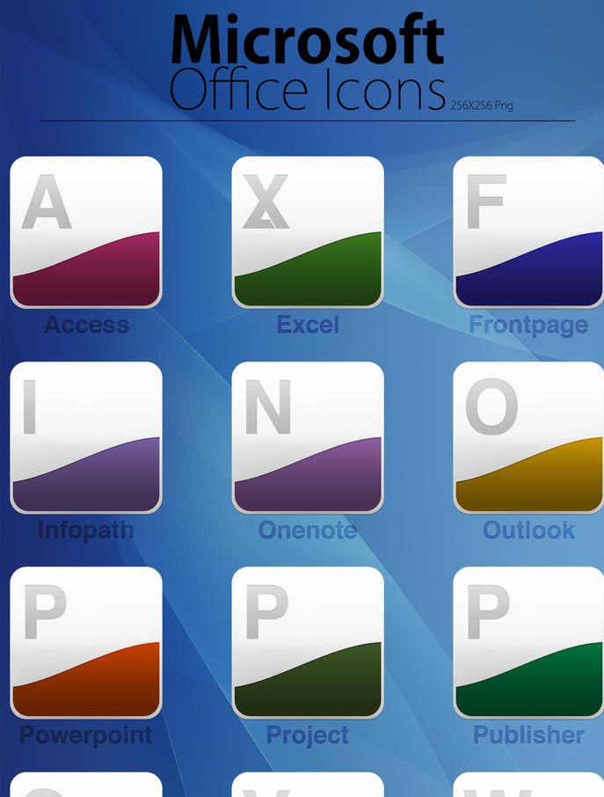
I. Computer
Software is the instructions that control what a computer does; computer programs
Office
Visual Code
Drivers

Slide 6
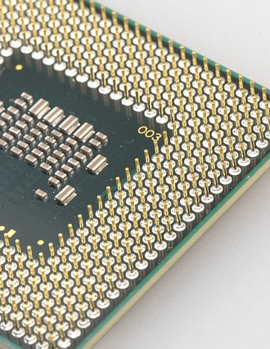
CPU Center Processing Unit
CPU is the brain of the computer. It executes instructions and control unit operations.

Slide 7
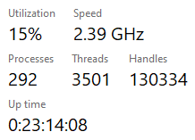
Process
Processes are basically the programs that are dispatched from the ready state and are scheduled in the CPU for execution. PCB ( Process Control Block ) holds the context of process.

Slide 8
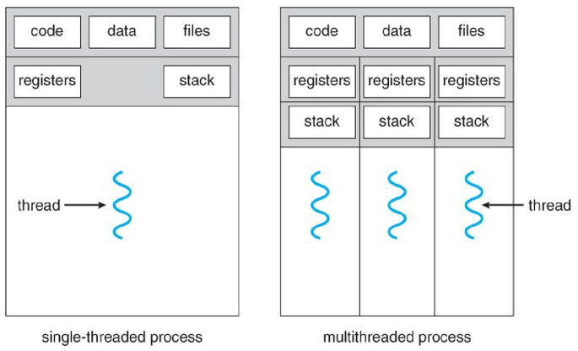
Thread
Thread is the segment of a process which means a process can have multiple threads and these multiple threads are contained within a process.

Slide 9
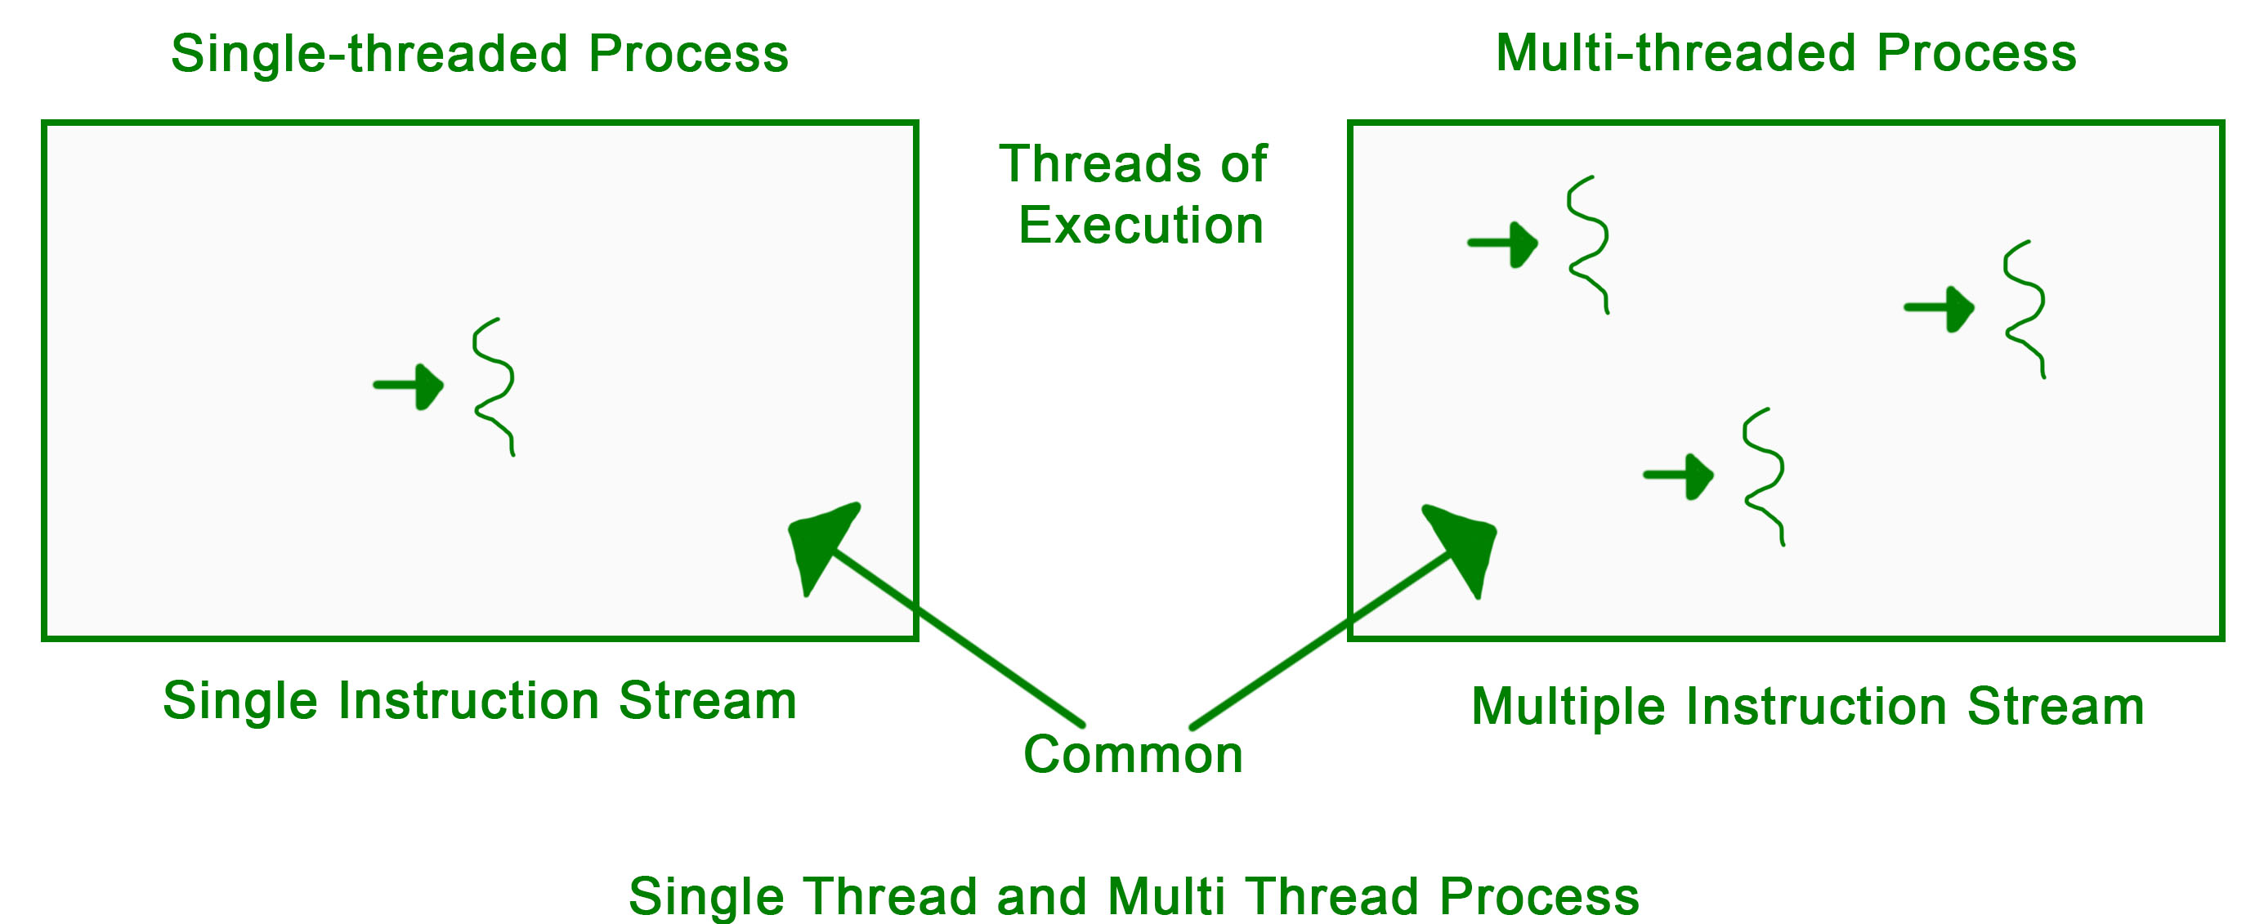
Multiple Threads
Multithreading is a feature in operating systems that allows a program to do several tasks at the same time.
Concurrent Execution
Parallel Execution

Slide 10
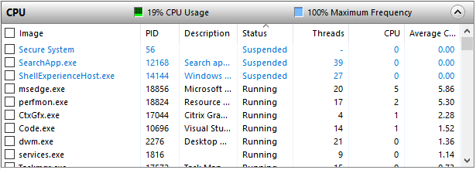
Multiple Threads
Multithreading is a feature in operating systems that allows a program to do several tasks at the same time.
Concurrent Execution
Parallel Execution

Slide 11
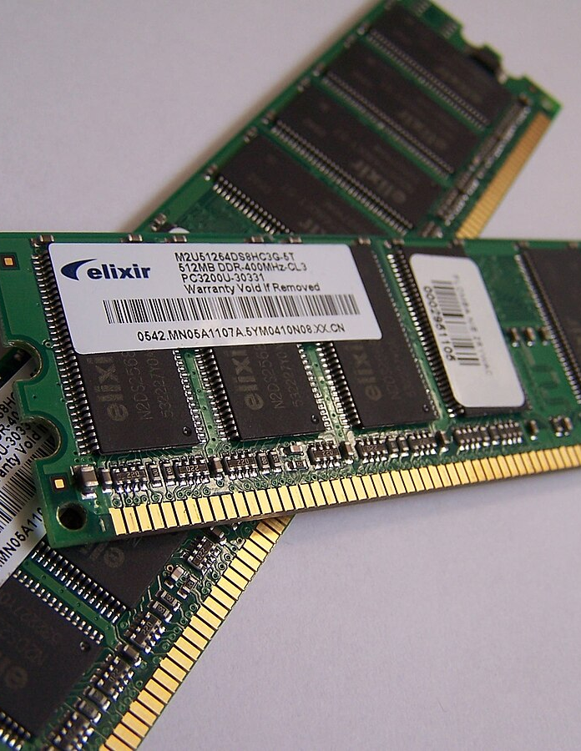
RAM Random Access Memory
RAM a type of computer memory that can be searched in any order and changed as necessary.

Slide 12
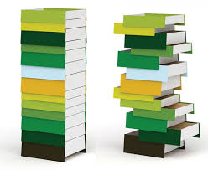
Stack
Stack Allocation: The allocation happens in the function call stack, on a contiguous blocks of memory.
Get allocated when function is called.
De-allocated when function is over

Slide 13
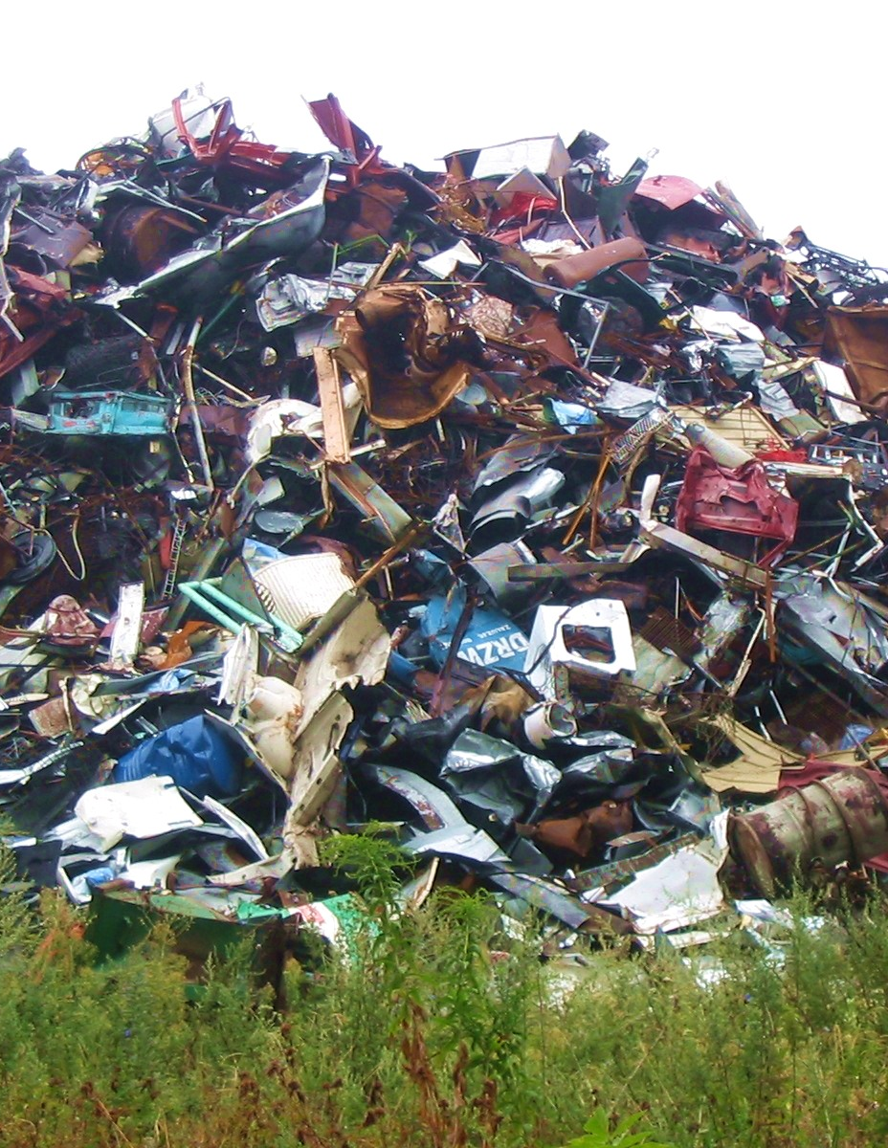
Heap
Heap is the memory which is allocated during the execution of instructions written by programmers
Every time when we made an object it always creates in Heap-space and the referencing information to these objects is always stored in Stack-memory

Slide 14
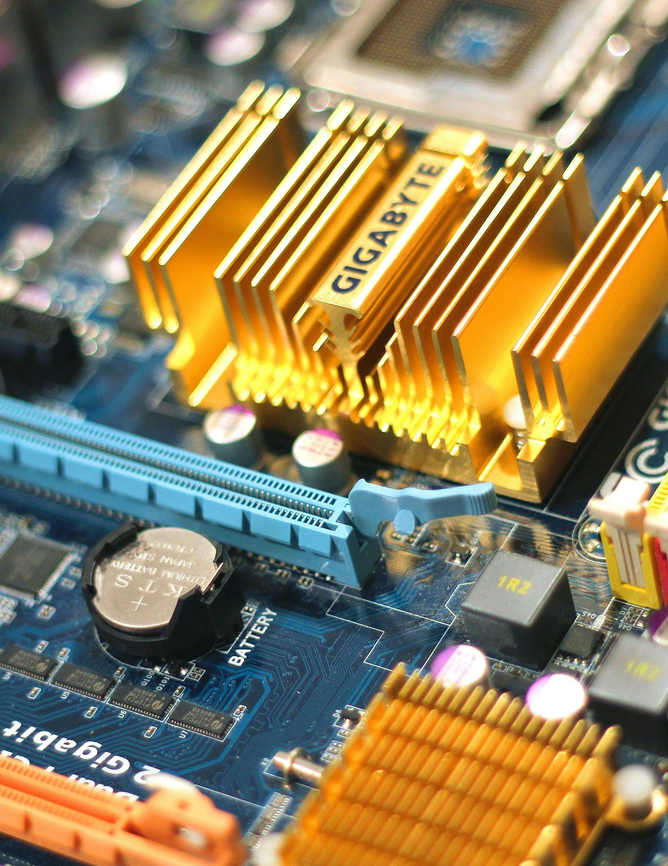
Motherboard Storage etc.
Motherboard
Storage
GPU
External devices

Slide 15
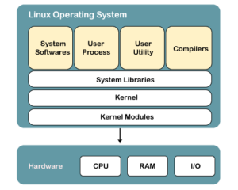
Operation System (OS)
An Operating System (OS) is a collection of software that manages computer hardware resources and provides common services for computer programs.

Slide 16
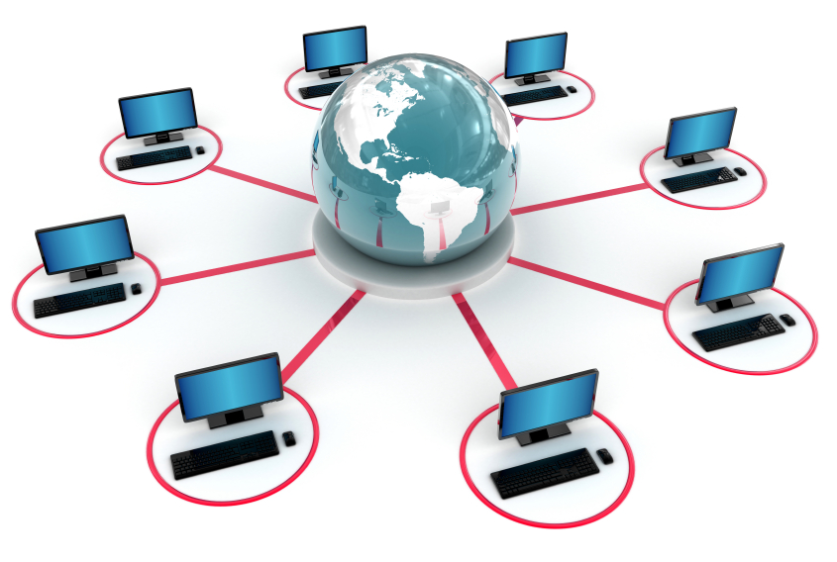
Network
OSI Layer
IP Address
Mac Address
TCP/IP

Slide 17
OSI Layer
7
Application layer: FTP, SMTP, Telnet
6
Presentation layer: Format, Encryption
5
Session layer: Start/Stop session
4
Transport layer: TCP, UCP, Port numbers
3
Network layer: IP address, routers
2
Data Link layer: MAC addresses switches
1
Physical layer: Cables, NIC, Hubs, etc.

Slide 18
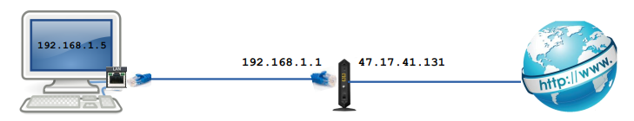
IP Address
IP V4: 192.168.1.30
IP V6: 4ggr:1925:5656:7:600:t4tt:tc54:98vt

Slide 19
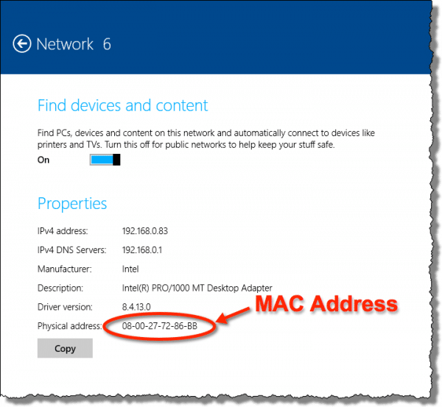
MAC Address
The IEEE (Institute of Electrical and Electronics Engineers) assigns manufacturers the numbers, called organizationally unique identifiers

Slide 20
TCP/IP
TCP stands for Transmission Control Protocol and IP stands for Internet Protocol
TCP is responsible for data delivery once an IP address has been found
IP obtains the address to which data is sent.

Slide 21
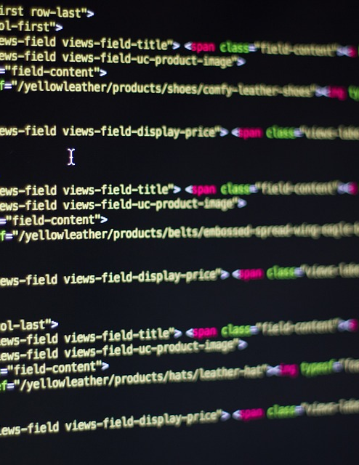
II. Programming
Introduction
Common Programming Languages
Basic of coding
Advanced: Algorithm

Slide 22
Introduction
Syntax
Variables
Control Structures
Operators
Data Types
Libraries
Paradigms
A programming language is set of instructions and syntax used to create software programs
E.g: Java, Nodejs

Slide 23

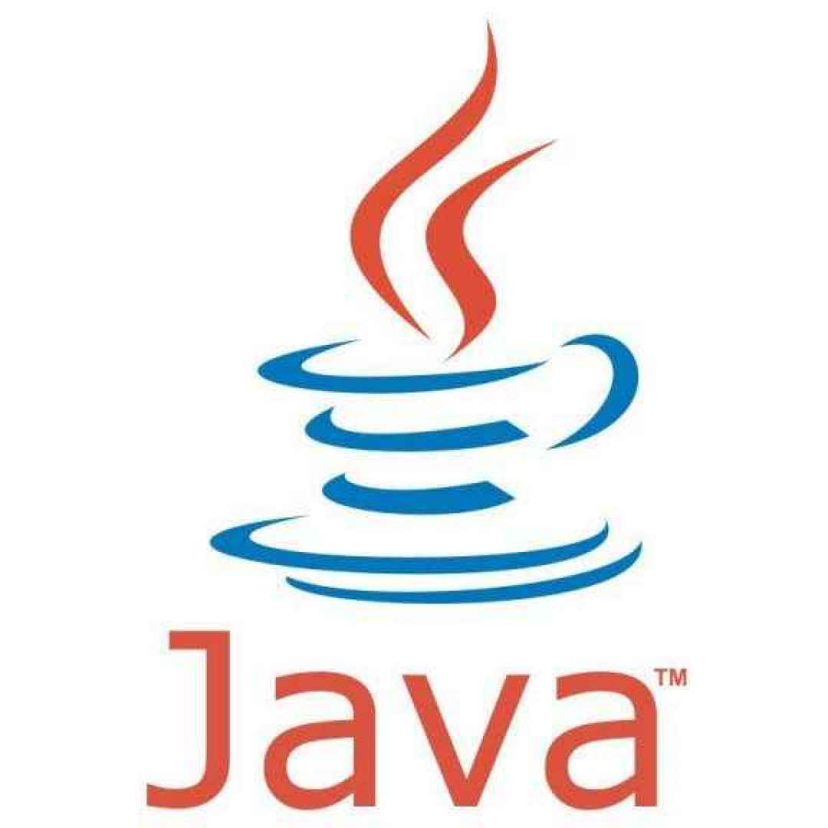


Common Programming Language
Java
Node
PHP
DotNet

Slide 24
Basic of Coding
Data Types
Number
String
Float, etc.
Structures
Loop
Conditional

Slide 25
Advanced: Algorithm
Search
Sort
Stack
Queue

Slide 26
III. Introduction to System Architecture
What is system architecture?
The example ?

Slide 27
What is System Architecture?
A system architecture is the conceptual model that defines the structure, behavior, and more views of a system.
An architecture description is a formal description and representation of a system, organized in a way that supports reasoning about the structures and behaviors of the system.

Slide 28
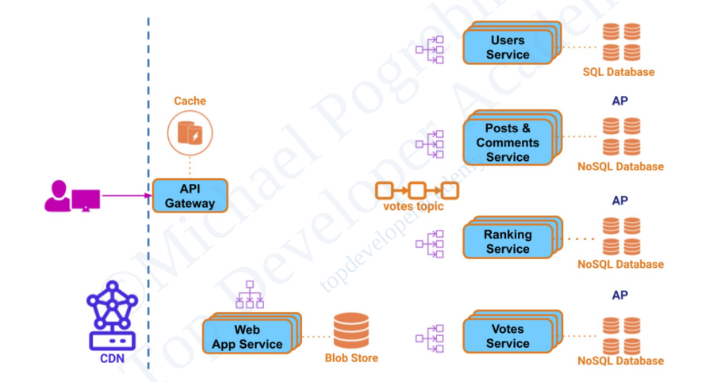

Slide 29
IV. Use case “DAPTalk”

Slide 30
Q&A

